Slide 1
DNN-HMM
Most slides come from https://www.inf.ed.ac.uk/teaching/courses/asr/2022-23/asr11-hybrid_hmm_nn.pdf
Ying shen
School of software engineering
Tongji university

Slide 2
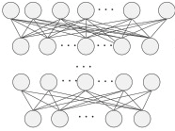






Why using DNN
The structure of GMM is shallow and the representative ability of GMM is not satisfied
DNN has a much deeper structure
GMM can be replaced by DNN
“a”
“o”
……………
$$s_{1}$$
$$s_{2}$$
$$s_{3}$$
$$s_{1}$$
$$s_{2}$$
$$s_{3}$$
………
0.4
0.4
0.4
0.4
0.4
0.4
0.35
0.35
0.35
0.35
0.35
0.35
0.3
0.3
0.3
0.3
0.3
0.3
0.25
0.25
0.25
0.25
0.25
0.25
0.2
0.2
0.2
0.2
0.2
0.2
0.15
0.15
0.15
0.15
0.15
0.15
0.1
0.1
0.1
0.1
0.1
0.1
0.05
0.05
0.05
0.05
0.05
0.05
0
0
0
-4
-3
-2
-1
0
1
2
3
4
-4
-3
-2
-1
0
1
2
3
4
0
-4
-3
-2
-1
0
1
2
3
4
0
0
-4
-3
-2
-1
0
1
2
3
4
-4
-3
-2
-1
0
1
2
3
4
-4
-3
-2
-1
0
1
2
3
4

Slide 3
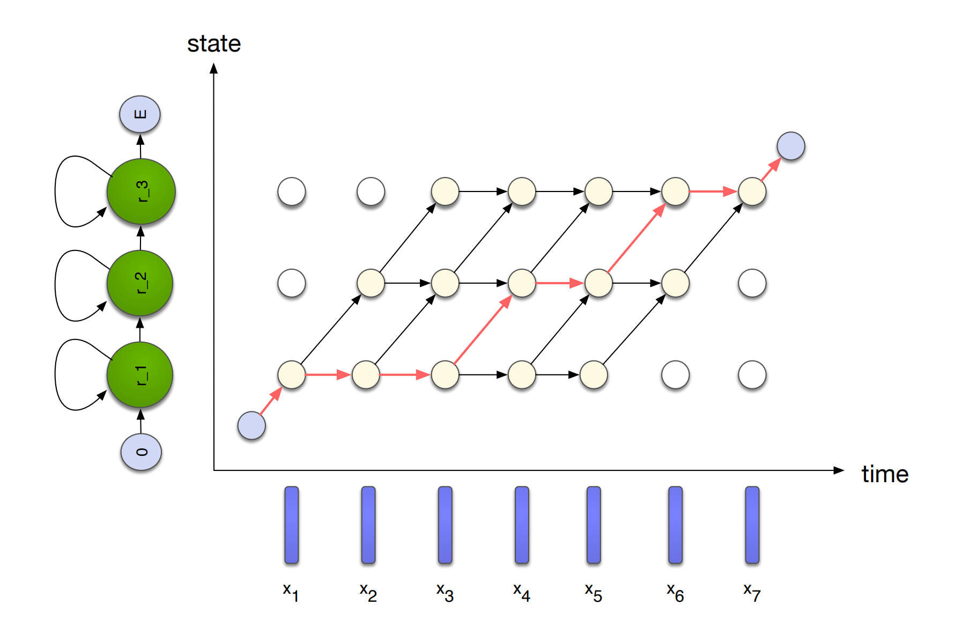
Local phonetic scores and sequence modelling
Compute state observation scores (acoustic-frame, phone-model) – this does the detailed matching at the frame-level
Chain observation scores together in a sequence – HMM

Slide 4
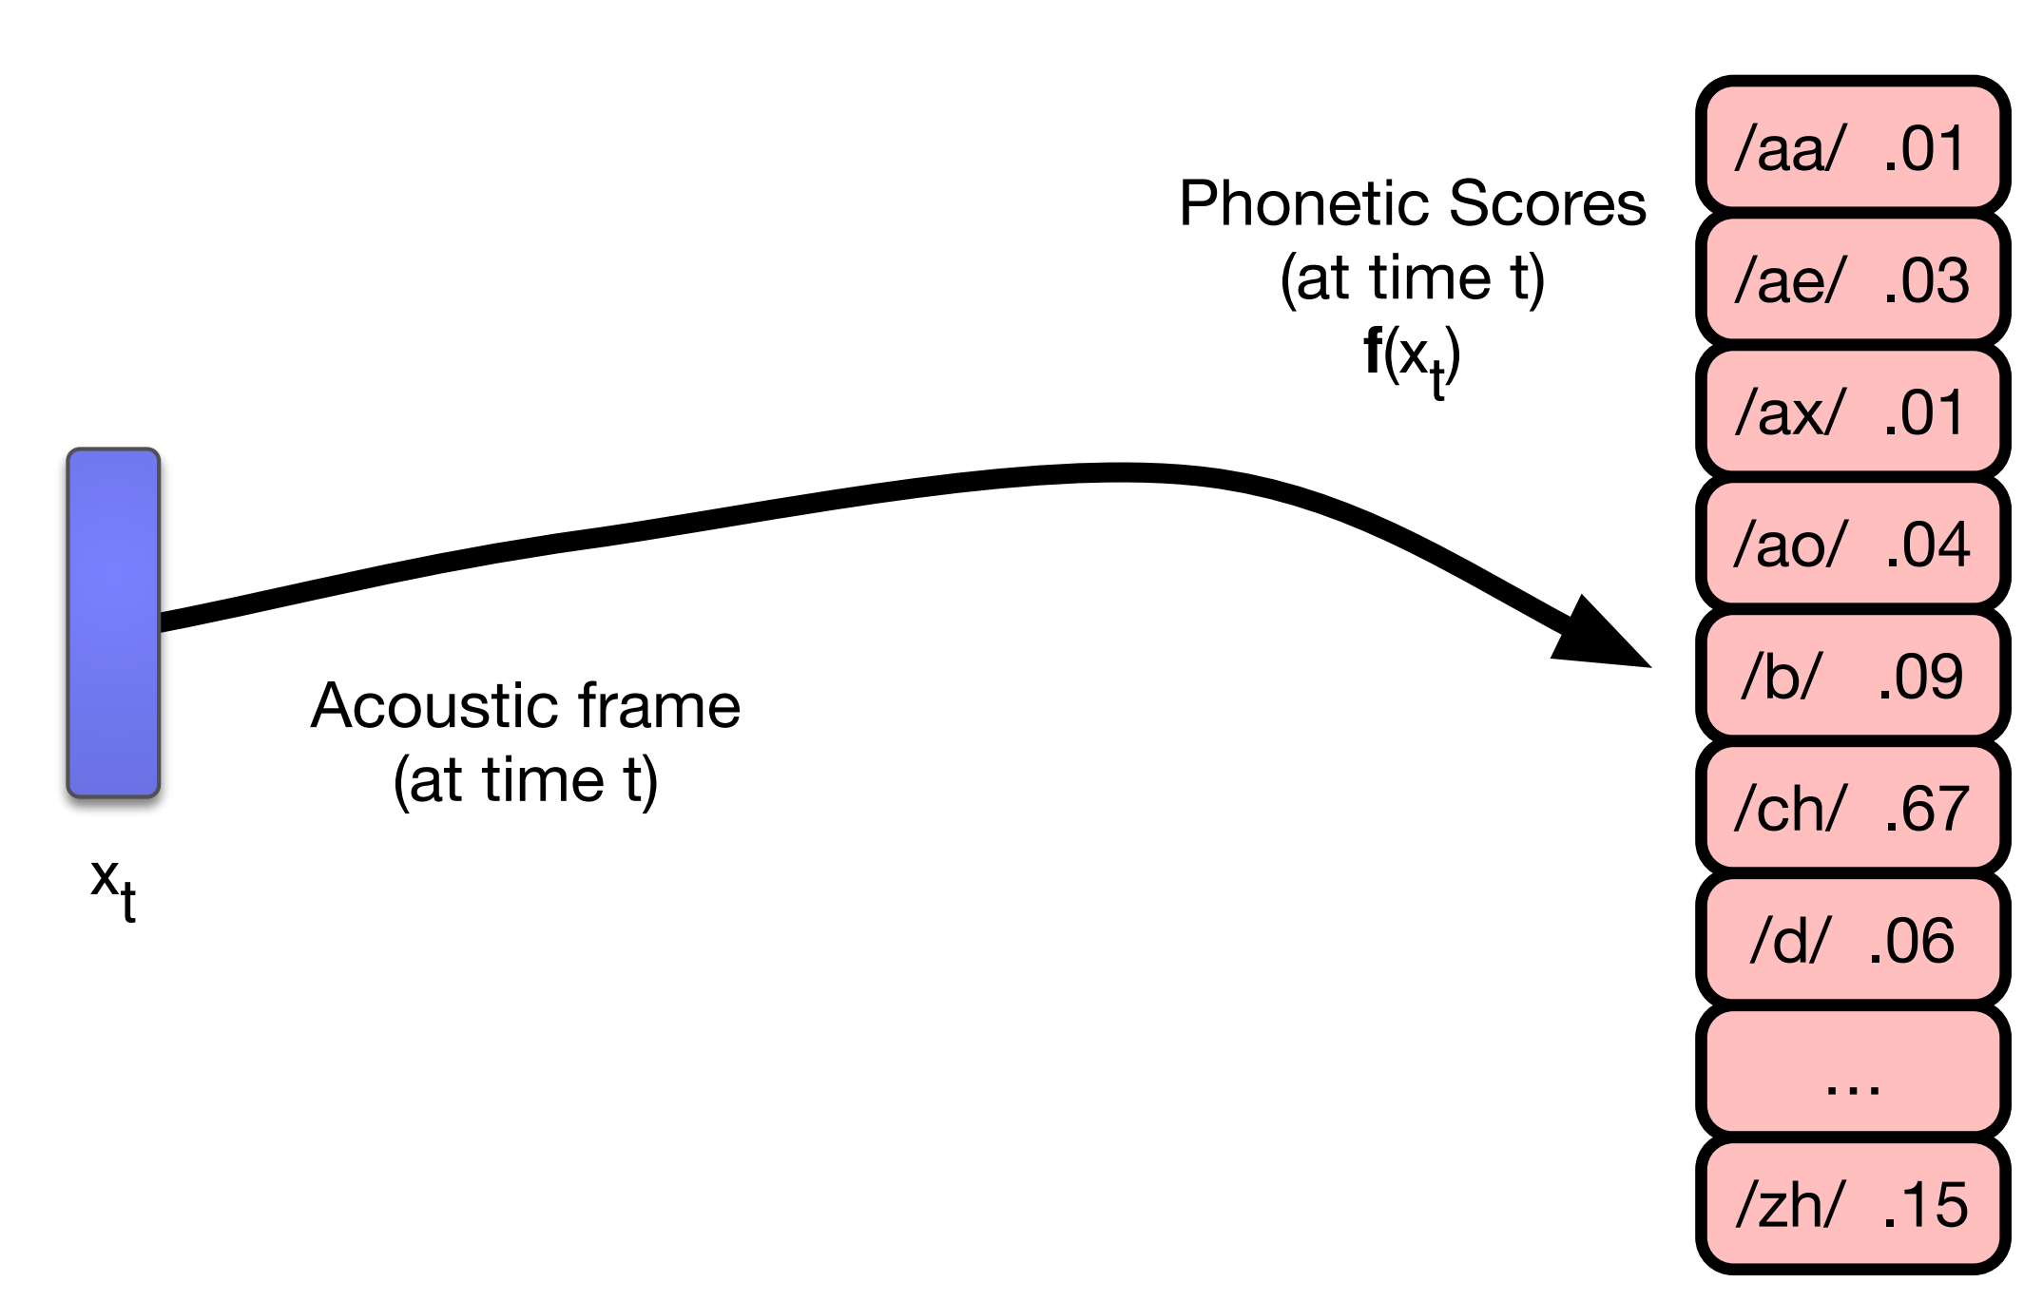
Phonetic scores
Task: given an input acoustic frame, output a score for each phone

Slide 5
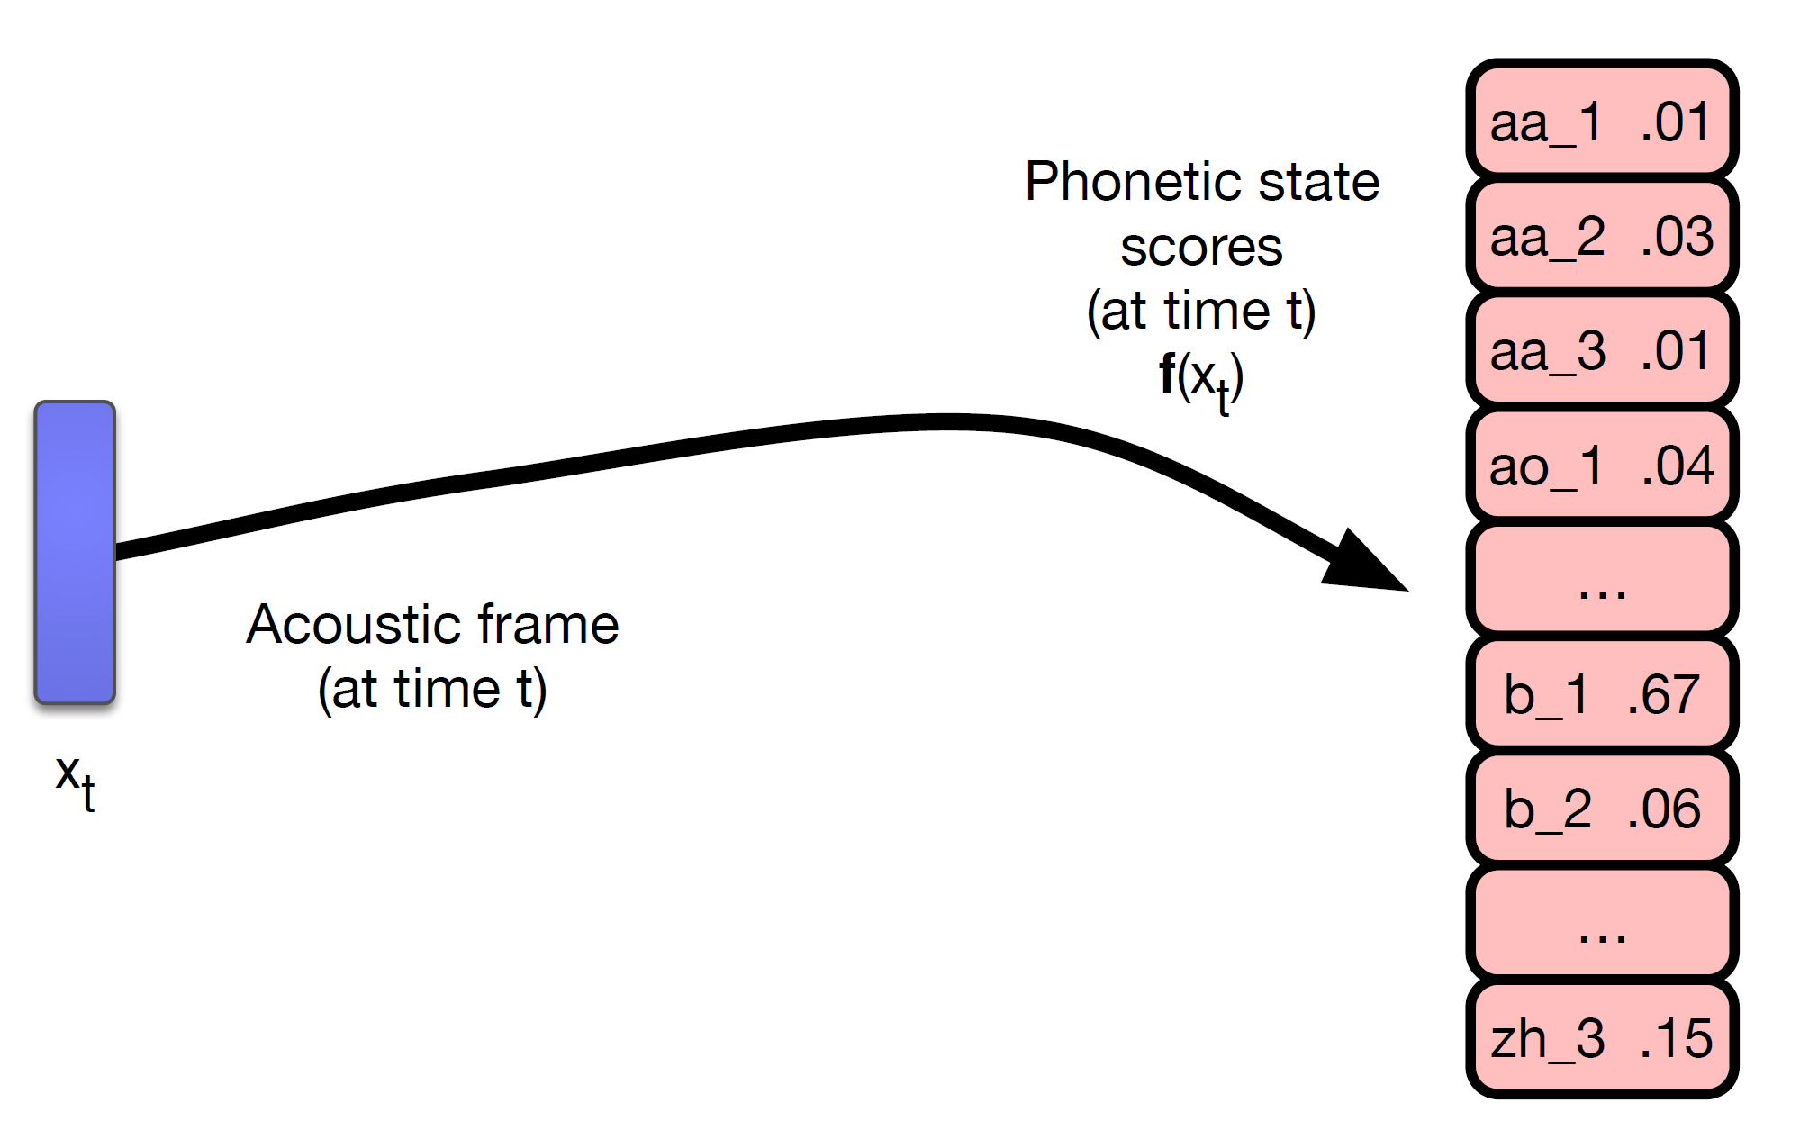
Phone state scores
Output a score for each phone state

Slide 6
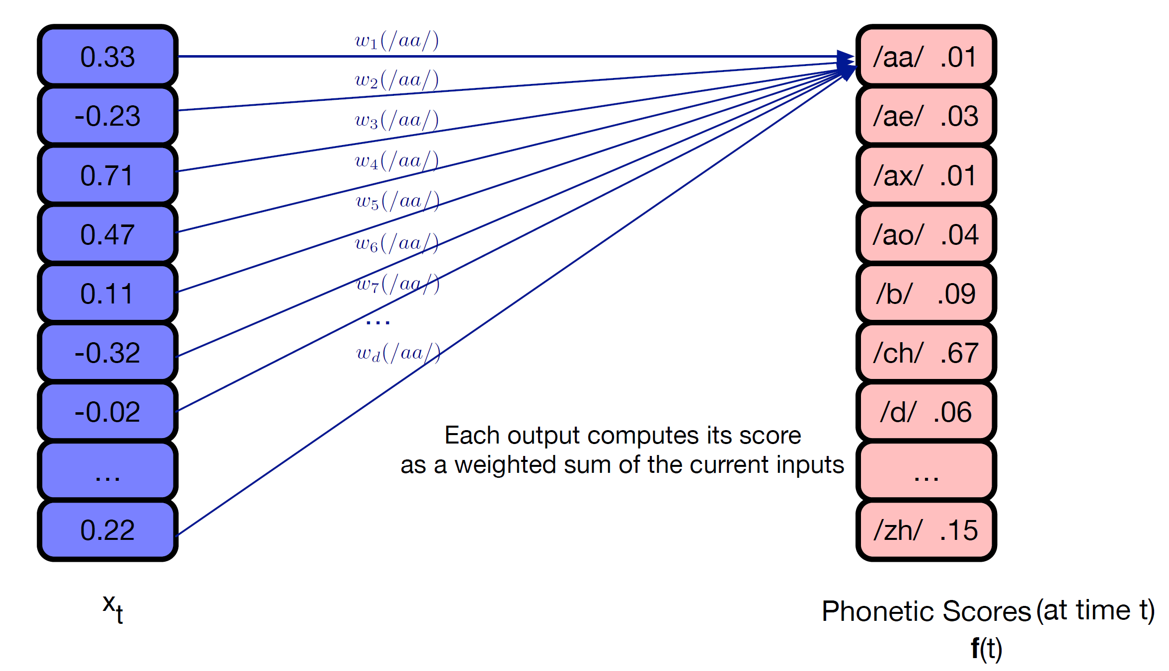
Phonetic scores
Compute the phonetic scores using a single layer neural network (linear regression!)

Slide 7
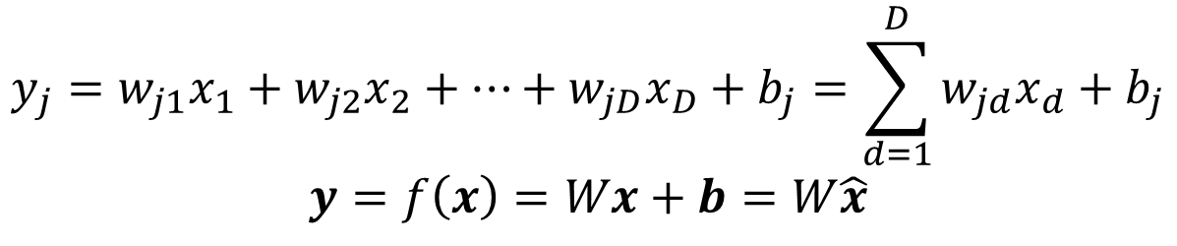
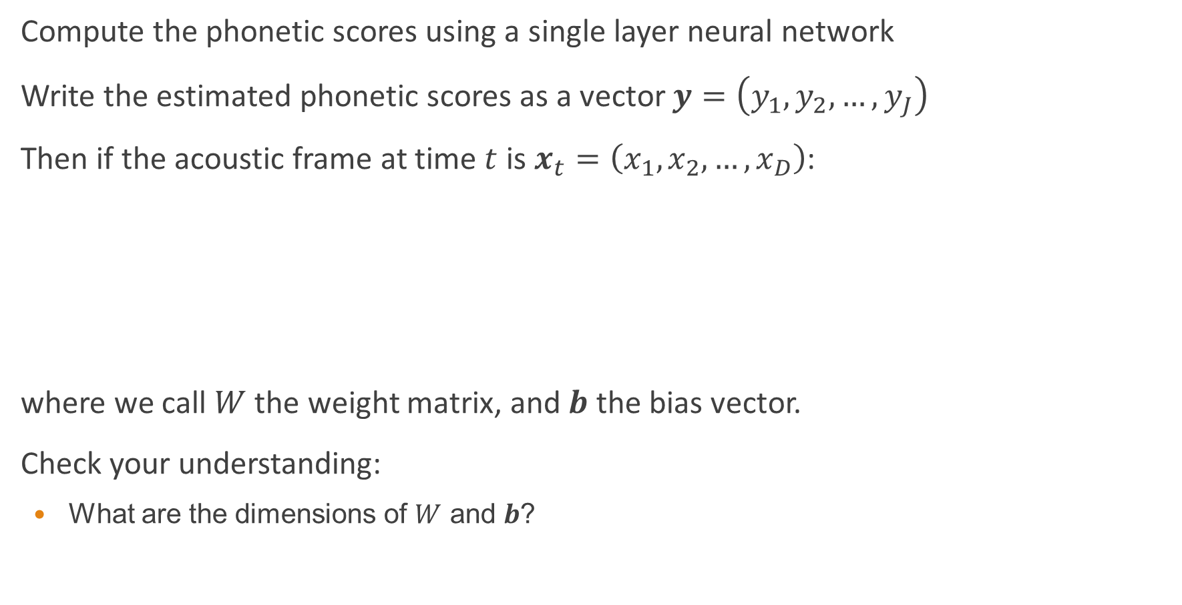
Phonetic scores
Compute the phonetic scores using a single layer neural network
Write the estimated phonetic scores as a vector $y=\left(y_{1},y_{2},…,y_{J}\right)$
Then if the acoustic frame at time $t$ is $x_{t}=\left(x_{1},x_{2},…,x_{D}\right)$:
where we call $W$ the weight matrix, and $b$ the bias vector.
Check your understanding:
What are the dimensions of $W$ and $b$?
$$y_{j}=w_{j1}x_{1}+w_{j2}x_{2}+…+w_{jD}x_{D}+b_{j}=\sum_{d=1}^{D}{w_{jd}x_{d}}+b_{j}$$
$$y=f\left(x\right)=Wx+b=W\hat{x}$$

Slide 8
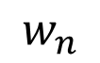
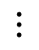
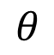
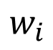
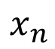
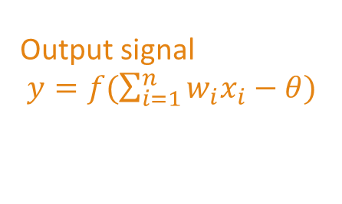
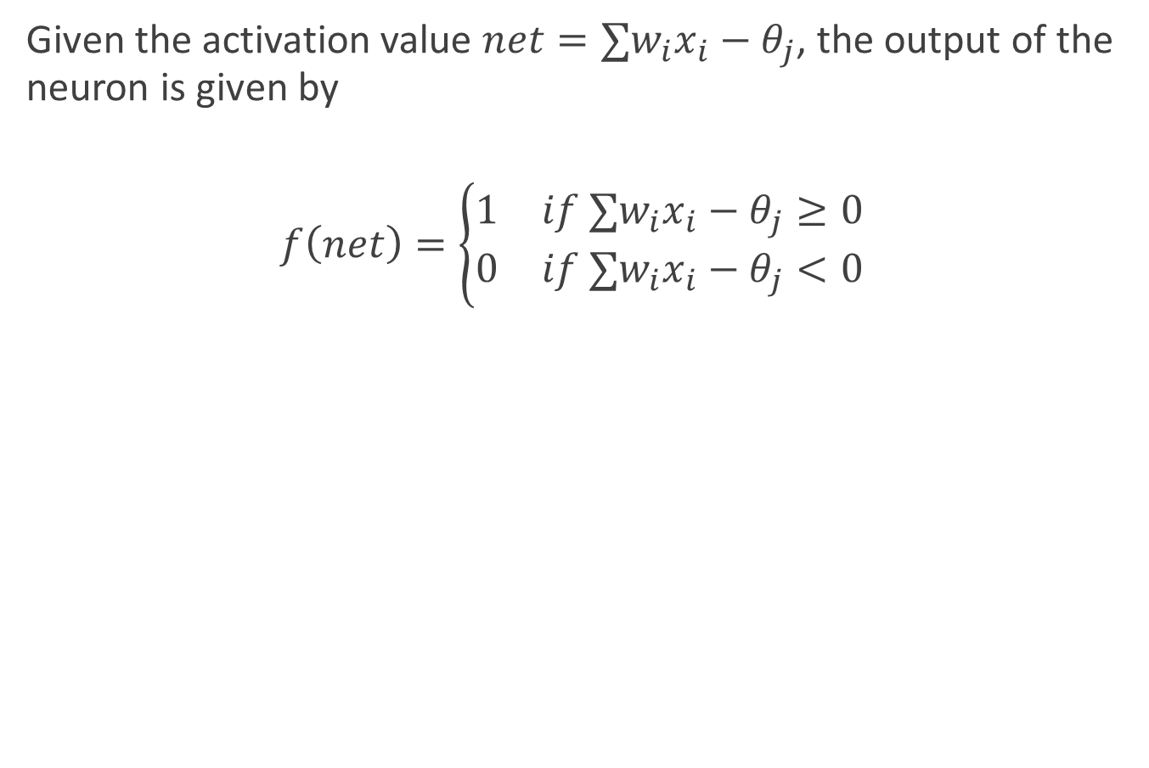
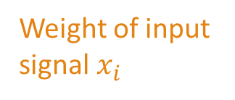
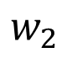
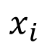
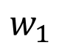
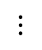
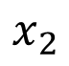
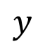
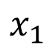
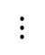
Artificial neuron
Given the activation value $net=∑w_{i}x_{i}−θ_{j}$, the output of the neuron is given by
$$f\left(net\right)=\left\{\begin{matrix}1 & if ∑w_{i}x_{i}−θ_{j}≥0 \\ 0 & if ∑w_{i}x_{i}−θ_{j}<0\end{matrix}\right.$$
Input signal from i-th neuron
A neuron
$$x_{1}$$
Output signal
$y=f(\sum_{i=1}^{n}{w_{i}x_{i}}−θ)$
$$w_{1}$$
$$x_{2}$$
$$w_{2}$$
$$y$$
$$⋮$$
$$⋮$$
$$θ$$
$$w_{i}$$
$$x_{i}$$
$$⋮$$
A threshold
$$w_{n}$$
$$x_{n}$$
Weight of input signal $x_{i}$

Slide 9
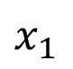
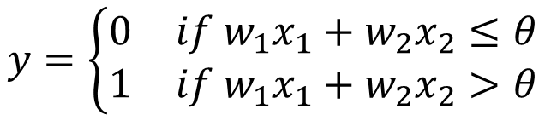
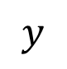
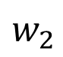
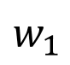
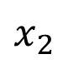
Perceptron
Perceptron consists of two layers of neurons
$$y$$
Output layer
$$w_{1}$$
$$w_{2}$$
Input layer
$$x_{1}$$
$$x_{2}$$
$$y=\left\{\begin{aligned}\begin{matrix}0 & if w_{1}x_{1}+w_{2}x_{2}≤θ\end{matrix} \\ \begin{matrix}1 & if w_{1}x_{1}+w_{2}x_{2}>θ\end{matrix}\end{aligned}\right.$$

Slide 10
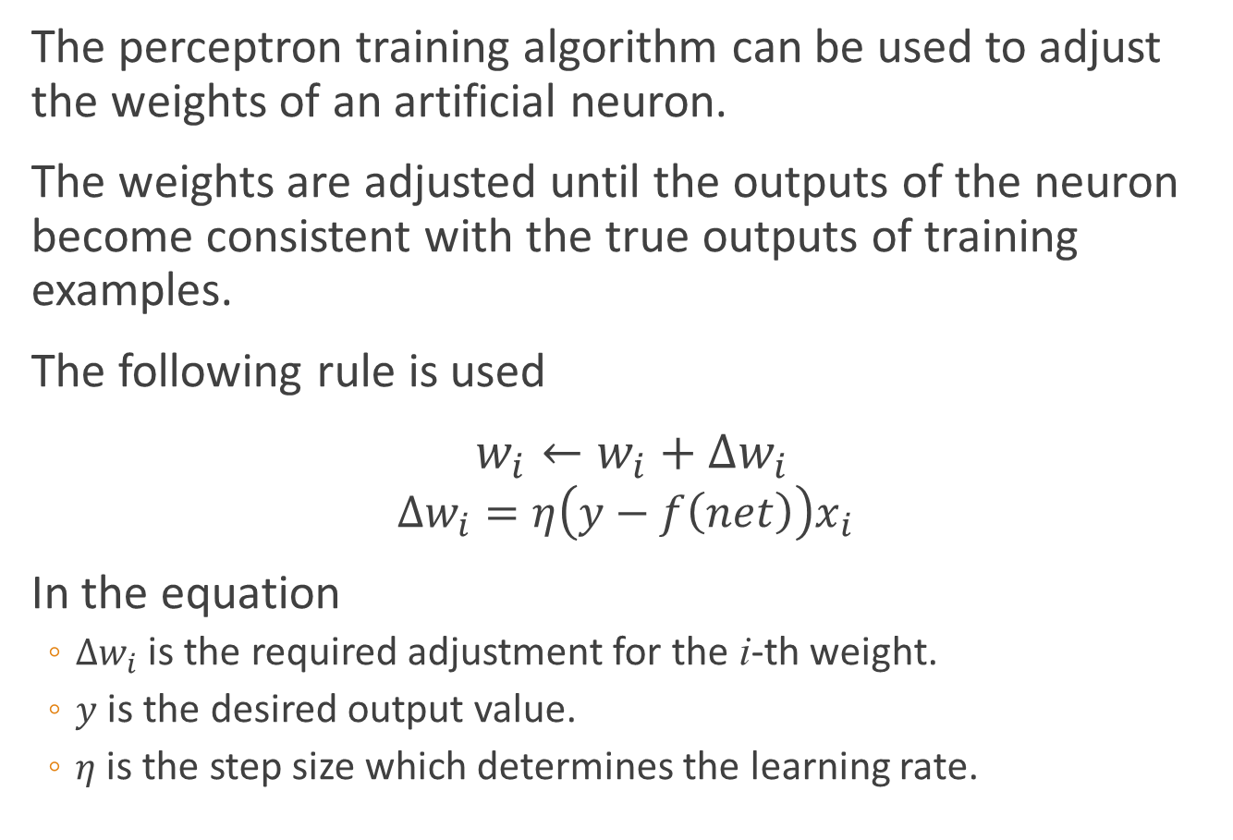
Perceptron
The perceptron training algorithm can be used to adjust the weights of an artificial neuron.
The weights are adjusted until the outputs of the neuron become consistent with the true outputs of training examples.
The following rule is used
$w_{i}←w_{i}+∆w_{i}$
$$∆w_{i}=η\left(y−f\left(net\right)\right)x_{i}$$
In the equation
$∆w_{i}$ is the required adjustment for the i-th weight.
$y$ is the desired output value.
$η$ is the step size which determines the learning rate.

Slide 11
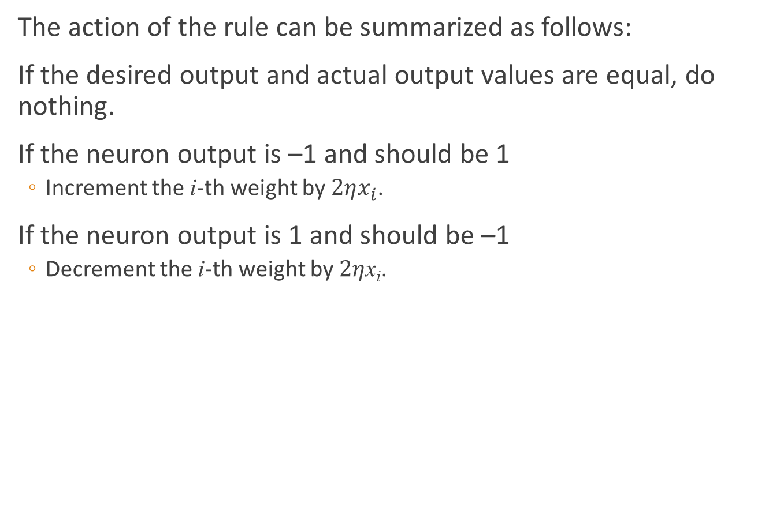
Perceptron
The action of the rule can be summarized as follows:
If the desired output and actual output values are equal, do nothing.
If the neuron output is –1 and should be 1
Increment the i-th weight by $2ηx_{i}$.
If the neuron output is 1 and should be –1
Decrement the i-th weight by $2η$x_{i}.

Slide 12
Example
A set of patterns are to be classified in a 2-D space.
The first two columns of the table list the 2-D coordinates of the patterns.
The third column represents the classification, +1 or – 1.
The patterns are linearly separable, i.e., they can be completely separated by a hyperplane.

Slide 13
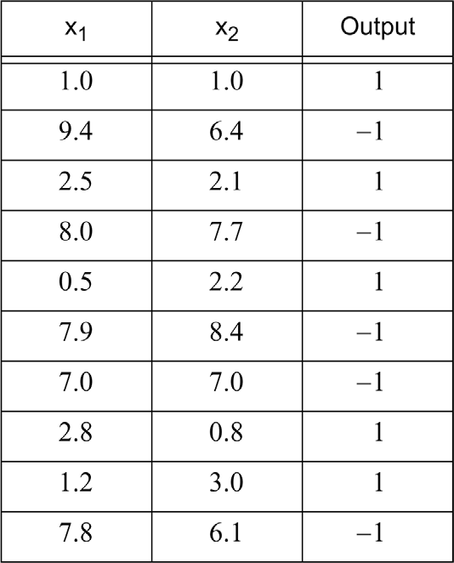
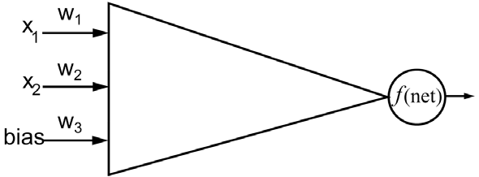
Example

Slide 14
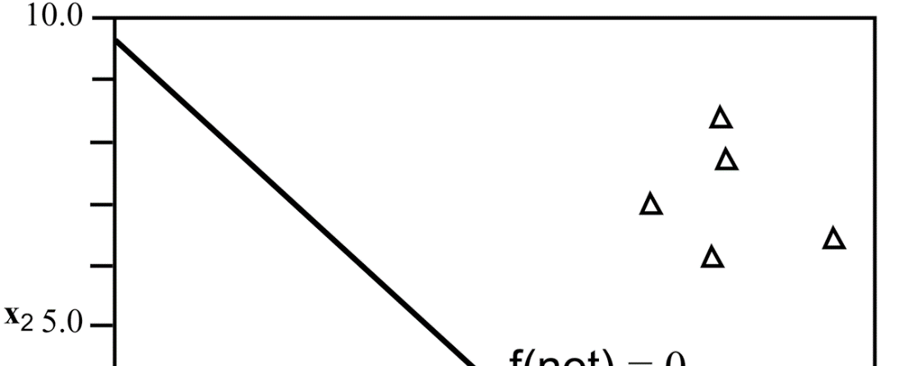
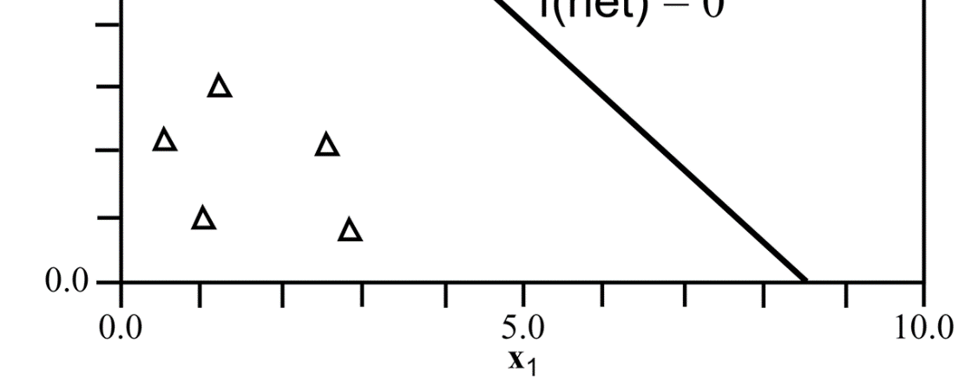
Example

Slide 15
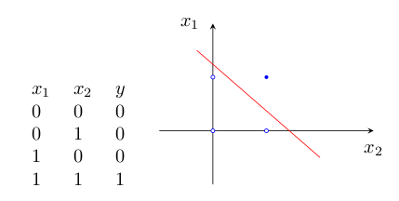
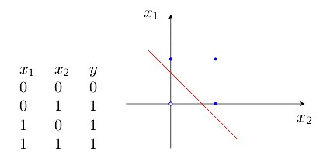
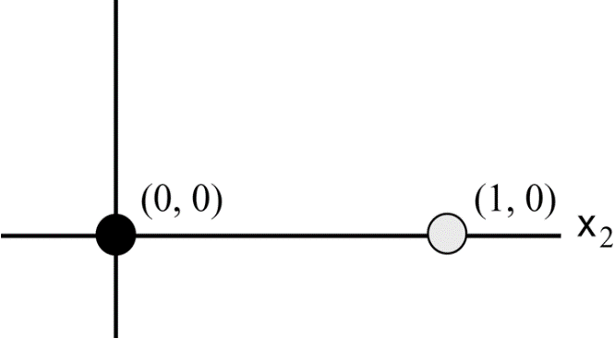
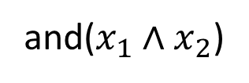
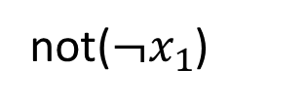
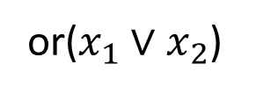
Exclusive-OR
Perceptron cannot solve those problems where the patterns are not linearly separable
An example of this is the exclusive-OR problem.
Multilayer networks are required for solving such kinds of problems.
+
-
and($x_{1}∧x_{2}$)
or($x_{1}∨x_{2}$)
not($¬x_{1}$)

Slide 16
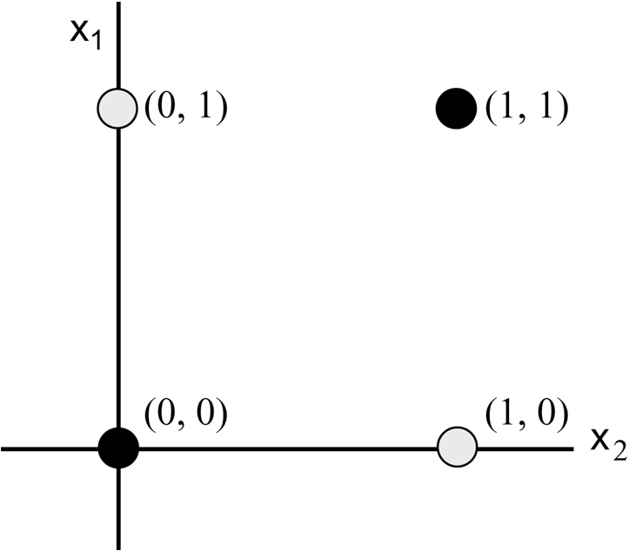
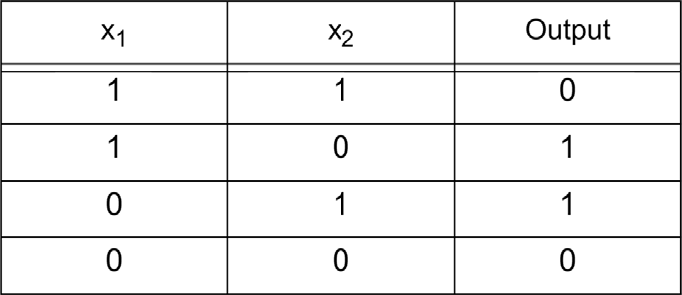



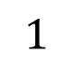

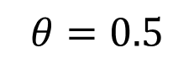
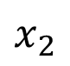
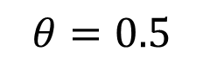
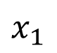
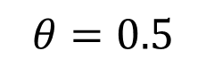
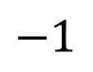


Exclusive-OR
-
+
-
$$θ=0.5$$
$$y$$
$$1$$
$$1$$
$$θ=0.5$$
$$θ=0.5$$
$$−1$$
$$−1$$
$$1$$
$$1$$
$$x_{1}$$
$$x_{2}$$

Slide 17


Error function
How do we learn the parameters $W$ and $b$?
Minimize an Error Function: Define a function which is 0 when the output $y_{t}=f(x_{t})$ equals the target output ${\hat{y}}_{t}$ for all $t$
Target output: for phone classification the target output corresponds to the phone label for each frame
Mean square error: define the error function $E$ as the mean square difference between output and the target:
where there are $T$ frames of training data in total
$$E=\frac{1}{2}⋅\frac{1}{T}\sum_{t=1}^{T}{{\left\|y_{t}−\hat{y}\right\|}^{2}}$$

Slide 18

Notes on the error function
$f$ is a function of the acoustic data $x$ and the weights and biases of the network ($W$ and $b$)
This means that as well as depending on the training data ($x_{t}$ and ${\hat{y}}_{t}$ ), $E$ is also a function of the weights and biases, since it is a function of $y$
We want to minimize the error function given a fixed training set: we must set $W$ and $b$ to minimize $E$
Weight space: given the training set we can imagine a space where every possible value of $W$ and $b$ results in a specific value of $E$. We want to find the minimum of $E$ in this weight space.
Gradient descent: find the minimum iteratively -- given a current point in weight space find the direction of steepest descent, and change $W$ and $b$to move in that direction

Slide 19

Backpropagation learning

Slide 20

Stochastic Gradient Descent Procedure
1. Initialize weights and biases with small random numbers
2. Randomize the order of training data examples
3. For each epoch (complete batch of training data)
Take a minibatch of training examples (e.g. 128 examples), and for all examples
Forward: compute the network outputs $y$
Backprop: compute the gradients and accumulate $∂E/∂w$ for the minibatch
Update the weights and biases using the accumulated gradients and the learning rate hyperparameter $η$: $w=w−η⋅∂E/∂w$
Terminate either after a fixed number of epochs, or when the error stops decreasing by more than a threshold.

Slide 21


Softmax
Our network that predicts phonetic scores is a classifier – at training time each frame of data has a correct label (target output of 1), other labels have a target output of 0
At test time the network produces real-valued outputs which we can interpret as the probability of the $j$th label given the input frame $x_{t}$, $P(q_{t}=j|x_{t})$
We can design an output layer which forces the output values to act like probabilities
Each output will be between 0 and 1
The K outputs will sum to 1
A way to do this is using the Softmax activation function:
$$y_{j}=\frac{\exp\left(a_{j}\right)}{\sum_{k=1}^{K}{\exp\left(a_{k}\right)}}, a_{j}=\sum_{d=1}^{D}{w_{jd}x_{d}}$$

Slide 22


Cross-entropy error function
Since we are interpreting the network outputs as probabilities, we can write an error function for the network which aims to maximize the log probability of the correct label.
If ${\hat{y}}_{j}^{t}$ is the 1/0 target of the $j$th label for the $t$th frame, and $y_{j}^{t}$ is the network output, then the cross-entropy (CE) error function is
Note that if the targets are 1/0 then the only the term corresponding to the correct label is non-zero in this summation.
$$E^{t}=−\sum_{j=1}^{J}{{\hat{y}}_{j}^{t}\ln{y_{j}^{t}}}$$

Slide 23

Cross entropy and softmax
A neat thing about softmax: if we train with cross-entropy error function, we get a simple form for the gradients of the output weights:
In statistics this is called logistic regression
Check your understanding:
Why does the cross-entropy error function correspond to maximizing the log probability of the correct label?
Why does the softmax output function ensure the set of outputs for a frame sums to 1?
Why are the target labels either 1 or 0?
Why does only one target label per frame take the value 1?
Why are the network outputs real numbers and not binary (1/0)?
$$\frac{∂E^{t}}{∂w_{jd}}=\left(y_{j}^{t}−{\hat{y}}_{j}^{t}\right)x^{d}$$

Slide 24

Extending the model: Acoustic context
Use multiple frames of acoustic context

Slide 25
Extending the model: Hidden layers
Single layer networks have limited computational power – each output unit is trained to match a spectrogram directly (a kind of discriminative template matching)
But there is a lot of variation in speech (as previously discussed) – rate, coarticulation, speaker characteristics, acoustic environment
Introduce an intermediate feature representation – layers of “hidden units” – more robust than template matching
Can have multiple hidden layers to learn successively more abstract representations – deep neural networks (DNNs)

Slide 26


Multi-layer feedforward neural network
The additional layers between the input and output nodes are called hidden layers.
The nodes embedded in these layers are called hidden nodes.
We focus on feedforward neural networks, in which the nodes in one layer are connected only to the nodes in the next layer.

Slide 27






















Multi-layer feedforward neural network
$$β_{j}=\sum_{h=1}^{q}{w_{hj}}b_{h}$$
output layer
$$y_{1}$$
$$y_{2}$$
……
$$y_{j}$$
……
$$y_{l}$$
$$w_{1j}$$
$$w_{2j}$$
$$w_{hj}$$
$$w_{qj}$$
hidden layer
$$b_{1}$$
$$b_{2}$$
……
$$b_{h}$$
……
$$b_{q}$$
$$v_{1h}$$
$$v_{2h}$$
$$v_{ih}$$
$$v_{dh}$$
input layer
$$x_{1}$$
$$x_{2}$$
……
$$x_{i}$$
……
$$x_{d}$$
$$α_{h}=\sum_{i=1}^{d}{v_{ih}}x_{i}$$

Slide 28


Hidden Units
$$α_{h}=f\left(\sum_{i=1}^{d}{v_{ik}x_{i}}\right),y_{j}=softmax\left(\sum_{h=1}^{q}{w_{hj}b_{h}}\right)$$

Slide 29



Sigmoid function
Derivative:
$$f\left(z\right)=\frac{1}{1+e^{−z}}$$
$$f^{′}\left(z\right)=\frac{∂f}{∂z}=\frac{e^{−z}}{{\left(1+e^{−z}\right)}^{2}}=f\left(z\right)\left(1−f\left(z\right)\right)$$

Slide 30



Rectified Linear Unit – ReLU
Derivative:
$$relu\left(z\right)=\max\left(0,z\right)$$
$${relu}^{′}\left(z\right)=\frac{∂}{∂z}relu(z)=\left\{\begin{matrix}0 & ifz≤0 \\ 1 & ifz>0\end{matrix}\right.$$

Slide 31

Training deep networks: Backprop and gradient descent
Hidden units make training the weights more complicated, since each hidden units affects the error function indirectly via all the output units
The credit assignment problem: what is the “error” of a hidden unit? how important is input-hidden weight $v_{ih}$ to output unit $j$?
Solution: back-propagate the gradients through the network – the gradient for a hidden unit output with respect to the error can be computed as the weighted sum of the deltas of the connected output units. (Propagate the $g$ values backwards through the network)
The back-propagation of error (backprop) algorithm thus provides way to propagate the error gradients through a deep network to allow gradient descent training to be performed

Slide 32


Backpropagation learning

Slide 33
Backpropagation learning
$$β_{j}=\sum_{h=1}^{q}{w_{hj}}b_{h}$$
output layer
$$y_{1}$$
$$y_{2}$$
……
$$y_{j}$$
……
$$y_{l}$$
$$w_{1j}$$
$$w_{2j}$$
$$w_{hj}$$
$$w_{qj}$$
hidden layer
$$b_{1}$$
$$b_{2}$$
……
$$b_{h}$$
……
$$b_{q}$$
$$v_{1h}$$
$$v_{2h}$$
$$v_{ih}$$
$$v_{dh}$$
input layer
$$x_{1}$$
$$x_{2}$$
……
$$x_{i}$$
……
$$x_{d}$$
$$α_{h}=\sum_{i=1}^{d}{v_{ih}}x_{i}$$

Slide 34




Backpropagation learning
The nodes in the network may use types of activation functions other than $sgn(x)$ function.
$$f(x)$$

Slide 35

Backpropagation learning
A common activation function is the sigmoid function
$$f\left(z\right)=\frac{1}{1+e^{−z}}$$
An important property of logistic function is that it is differentiable
$$f^{′}\left(z\right)=f\left(z\right)\left(1−f\left(z\right)\right)$$

Slide 36

Backpropagation learning
Suppose the output of nn is ${\hat{y}}_{k}=({\hat{y}}_{1}^{k},{\hat{y}}_{2}^{k},…,{\hat{y}}_{l}^{k})$ corresponding to the training sample $(x_{k},y_{k})$
${\hat{y}}_{j}^{k}=f(β_{j}−θ_{j})$
The mean squared network error $E_{k}$ of nn w.r.t sample $(x_{k},y_{k})$ is computed by summing the error for each output node
$$E_{k}=\frac{1}{2}\sum_{j=1}^{l}{{\left({\hat{y}}_{j}^{k}−y_{j}^{k}\right)}^{2}}$$
${\hat{y}}_{j}^{k}$is the desired value for the j-th output node
$y_{j}^{k}$ is the actual output of the same node.

Slide 37

Backpropagation learning
For the h-th weight of the j-th node, the gradient descent operation is represented as
$$∆w_{hj}=−η\frac{∂E}{∂w_{hj}}$$
In the equation, the partial derivative measures the rate of change of error with respect to the h-th weight.
The evaluation of the partial derivative requires an activation function which is differentiable.

Slide 38




Backpropagation learning
Then we have
According to the definition of $β_{j}=\sum_{h=1}^{q}{w_{hj}}b_{h}$,
And $f^{′}\left(z\right)=f\left(z\right)\left(1−f\left(z\right)\right)$
$$∆w_{hj}=−η\frac{∂E_{k}}{∂w_{hj}}=−η⋅\frac{∂E_{k}}{∂{\hat{y}}_{j}^{k}}⋅\frac{∂{\hat{y}}_{j}^{k}}{∂β_{j}}⋅\frac{∂β_{j}}{∂w_{hj}}$$
$$\frac{∂β_{j}}{∂w_{hj}}=b_{h}$$
$$g_{j}=−\frac{∂E_{k}}{∂{\hat{y}}_{j}^{k}}⋅\frac{∂{\hat{y}}_{j}^{k}}{∂β_{j}}=−\left({\hat{y}}_{j}^{k}−y_{j}^{k}\right)f^{′}\left(β_{j}−θ_{j}\right)={\hat{y}}_{j}^{k}\left(1−{\hat{y}}_{j}^{k}\right)\left({y_{j}^{k}−\hat{y}}_{j}^{k}\right)$$

Slide 39


Backpropagation learning
Therefore,
$∆w_{hj}=ηg_{j}b_{h}$
Similarly, we can have
$∆θ_{j}=−ηg_{j}$
$∆v_{ih}=ηe_{h}x_{i}$
$∆γ_{h}=−ηe_{h}$
where
$$e_{h}=−\frac{∂E_{k}}{∂b_{h}}⋅\frac{∂b_{h}}{∂α_{h}}=−\frac{∂E_{k}}{∂β_{j}}⋅\frac{∂β_{j}}{∂b_{h}}f′(α_{h}−γ_{h})$$
$$=b_{h}\left(1−b_{h}\right)\sum_{j=1}^{l}{w_{hj}g_{j}}$$

Slide 40

BP algorithm
Input: Training set $D=\left\{\left(x_{1},y_{1}\right),\left(x_{2},y_{2}\right),…,\left(x_{m},y_{m}\right)\right\};$
Process:
1: Initialize weights and thresholds in nn randomly using values from (0, 1)
2: $repeat$
3: $for all \left(x_{k},y_{k}\right)∈D \text{do}$
4: $output {\hat{y}}_{k} using current weights and thresholds$
5: $compute g_{i} and e_{h}$
6: $update w_{hj},v_{ih}, and θ_{j}, γ_{j}$
7: $end for$
8: $until satisfying stop condition$
Output: A feedforward neural network with fixed weights and thresholds

Slide 41

Backpropagation learning

Slide 42
DNN-HMM的训练
Step1：利用GMM-HMM系统，生成训练数据帧与状态的对齐；
Step2：构建DNN-HMM，将GMM-HMM的HMM提取出来作为DNN-HMM中的HMM，GMM则用整个DNN替换，音素的后验概率则可以通过DNN的输出向量得到；
Step3：优化DNN-HMM，通过反向传播算法从音素级别的帧对齐序列中得到DNN的参数。

Slide 43

Step1: 帧与状态的对齐
“a”
“o”
s₁
s₂
s₃
s₄
s₅
s₁
s₂
s₃
s₄
s₅
训练标注
$$o_{1}:a(2)$$
$$o_{2}:a(2)$$
$$o_{3}:a(3)$$
$$⋮$$
$$o_{T}:o(4)$$
输入层(声学特征)
O₁
O₂
O₃
O_{T}

Slide 44





Step2: 构建DNN-HMM
“a”
“o”
s₁
s₂
s₃
s₄
s₅
s₁
s₂
s₃
s₄
s₅
$$y_{1}$$
$$y_{2}$$
$$y_{3}$$
$$y_{K−1}$$
$$y_{K}$$
K个节点

Slide 45

Step2: 构建DNN-HMM
“a”
“o”
s₁
s₂
s₃
s₄
s₅
s₁
s₂
s₃
s₄
s₅
$$y_{1}$$
$$y_{2}$$
$$y_{3}$$
$$y_{K−1}$$
$$y_{K}$$
K个节点
前向输出
$${p(o}_{1}\left|a\left(2\right)\right)=y_{1}$$
$${p(o}_{1}\left|a\left(3\right)\right)=y_{2}$$
$${p(o}_{1}\left|a\left(4\right)\right)=y_{3}$$
$$⋮$$
$${p(o}_{1}\left|o\left(4\right)\right)=y_{K}$$
输入层(声学特征)
O₁

Slide 46

Step3: 反向传播优化DNN-HMM
“a”
“o”
s₁
s₂
s₃
s₄
s₅
s₁
s₂
s₃
s₄
s₅
$$y_{1}$$
$$y_{2}$$
$$y_{3}$$
$$y_{K−1}$$
$$y_{K}$$
K个节点
训练标注
$$o_{1}\sim a\left(2\right):{\hat{y}}_{1}\left(1\right)$$
$$o_{2}\sim a(2):{\hat{y}}_{1}\left(2\right)$$
$$o_{3}\sim a(3):{\hat{y}}_{2}\left(3\right)$$
$$⋮$$
$$o_{T}\sim o(4):{\hat{y}}_{K}\left(T\right)$$
输入层(声学特征)
O₁
O₂
O₃
O_{T}

Slide 47

Step3: 反向传播优化DNN-HMM
“a”
“o”
s₁
s₂
s₃
s₄
s₅
s₁
s₂
s₃
s₄
s₅
$$y_{1}$$
$$y_{2}$$
$$y_{3}$$
$$y_{K−1}$$
$$y_{K}$$
K个节点
错误损失
$$C=−\sum_{t=1}^{T}{\sum_{k=1}^{K}{{\hat{y}}_{k}\left(t\right)lny_{k}(t)}}$$
训练标注
$$o_{1}\sim a\left(2\right):{\hat{y}}_{1}\left(1\right)$$
$$o_{2}\sim a(2):{\hat{y}}_{1}\left(2\right)$$
$$o_{3}\sim a(3):{\hat{y}}_{2}\left(3\right)$$
$$⋮$$
$$o_{T}\sim o(4):{\hat{y}}_{K}\left(T\right)$$
输入层(声学特征)
O₁
O₂
O₃
O_{T}

Slide 48

Training DNNs using backprop

Slide 49

Multiple hidden layers

Slide 50

Simple neural network for phone classification

Slide 51
Different DNNs
CNN
RNN
LSTM
GRU
TDNN
TDNN-F

Slide 52


CNN
语音信号可以用语谱图来表示，因此可借鉴图像处理的方式，采用卷积神经网络，在时间轴和频率轴上提取局部特征，如下图所示。
Deep CNN提取局部特征过程

Slide 53
CNN的输入
特征维度：40 (FBank)
连续3帧
则CNN的输入维度(input_dim)为：40*3

Slide 54
输入特征
FBank特征
频
率
轴
40

Slide 55
1个filter输出
FBank特征
频
率
轴
40
3
时间轴(帧数)：3
单个filter: 3*3

Slide 56
1个filter输出
输入特征
2 | 4 | -3
5 | 9 | 7
6 | 8 | -1
filter
36
1 | 0 | -1
0 | 1 | 1
1 | 1 | -1
3 | 5 | 8
-1 | 4 | 7
9 | 11 | 2
24
$$2×1+4×0+\left(−3\right)×\left(−1\right)+5×0+9×1+7×1+6×1+8×1+\left(−1\right)×\left(−1\right)=36$$
$$3×1+5×0+8×\left(−1\right)+(−1)×0+4×1+7×1+9×1+11×1+2×\left(−1\right)=24$$

Slide 57
1个filter输出
FBank特征
频
率
轴
40
3
时间轴(帧数)：3
单个filter: 3*3
频率轴步进为1，特征维度40，则filter输出节点：(40-3)/1+1=38

Slide 58
1个filter输出
FBank特征
频
率
轴
40
38维
时间轴(帧数)：3
单个filter: 3*3
频率轴步进为1，特征维度40，则filter输出节点：(40-3)/1+1=38

Slide 59
N个filter输出
输出特征
38维
filter个数
N=64
使用的filter: 3x3x64
num_filters

Slide 60
max-pooling输出
pool_size=3
pool_size=3
max
max
max
max
max
max
max
max
max
max
filter输出特征
max
max
max
max
max
max
max-pooling
输出特征
max
max
max
max
max
max
filter个数

Slide 61


RNN
View an RNN for a sequence of T inputs as a T-layer network with shared weights
Train by doing backpropagation through this unfolded network
Recurrent hidden units are state units: can keep information through time
State units as memory – remember things for (potentially) an infinite time
State units as information compression – compress the history (sequence observed up until now) into a state representation

Slide 62



Simple recurrent network unit
$$g\left(t\right)=W_{hx}x\left(t\right)+W_{hh}h\left(t−1\right)$$
$$h\left(t\right)=\tanh{g(t)}$$
$$=\tanh\left(W_{hx}x\left(t\right)+W_{hh}h\left(t−1\right)\right)$$
$$=\tanh\left(W_{hx}x\left(t\right)+W_{hh}\tanh\left(W_{hx}x\left(t−1\right)+W_{hh}h\left(t−2\right)\right)\right)$$
$$=\tanh\left(W_{hx}x\left(t\right)+W_{hh}\tanh\left(W_{hx}x\left(t−1\right)+…\right)\right)$$

Slide 63




LSTM
Internal recurrent state (“cell”) $c(t)$ combines previous state $c(t−1)$ and LSTM input $g(t)$
Gates - weights dependent on the current input and the previous state
Notes:
Understanding LSTM Networks -- colah's blog
The LSTM does have the ability to remove or add information to the cell state, carefully regulated by structures called gates.
Gates are a way to optionally let information through. They are composed out of a sigmoid neural net layer and a pointwise multiplication operation.
The sigmoid layer outputs numbers between zero and one, describing how much of each component should be let through. A value of zero means “let nothing through,” while a value of one means “let everything through!”
An LSTM has three of these gates, to protect and control the cell state.

Slide 64


LSTM – Input and Forget Gate
Forget gate: controls how much of the previous internal state $C(t−1)$ is written to the internal state $C(t)$
Notes:
The first step in our LSTM is to decide what information we’re going to throw away from the cell state. This decision is made by a sigmoid layer called the “forget gate layer.” It looks at h_t−1 and x_t, and outputs a number between 0 and 1 for each number in the cell state C_t−1. A 1 represents “completely keep this” while a 0 represents “completely get rid of this.”
Let’s go back to our example of a language model trying to predict the next word based on all the previous ones. In such a problem, the cell state might include the gender of the present subject, so that the correct pronouns can be used. When we see a new subject, we want to forget the gender of the old subject.

Slide 65


LSTM – Input and Forget Gate
Input gate: controls how much input to the unit is written to the internal state $C(t)$
Input and forget gates together allow the network to control what in $C(t)$
Notes:
The next step is to decide what new information we’re going to store in the cell state. This has two parts. First, a sigmoid layer called the “input gate layer” decides which values we’ll update. Next, a tanh layer creates a vector of new candidate values, C~t, that could be added to the state. In the next step, we’ll combine these two to create an update to the state.
In the example of our language model, we’d want to add the gender of the new subject to the cell state, to replace the old one we’re forgetting.

Slide 66

LSTM – Input and Forget Gate
Notes:
It’s now time to update the old cell state, Ct−1, into the new cell state Ct. The previous steps already decided what to do, we just need to actually do it.
We multiply the old state by ft, forgetting the things we decided to forget earlier. Then we add it∗C~t. This is the new candidate values, scaled by how much we decided to update each state value.
In the case of the language model, this is where we’d actually drop the information about the old subject’s gender and add the new information, as we decided in the previous steps.

Slide 67

LSTM – Input, Forget and Output Gates
Output gate: controls how much of each unit’s activation is output by the hidden state – it allows the LSTM cell to keep information that is not relevant at the current time, but may be relevant later
Avoids the vanishing gradient problem of conventional RNNs
C Olah (2015), Understanding LSTMs, http: //colah.github.io/posts/2015-08-Understanding-LSTMs/
Notes:
Finally, we need to decide what we’re going to output. This output will be based on our cell state, but will be a filtered version. First, we run a sigmoid layer which decides what parts of the cell state we’re going to output. Then, we put the cell state through tanh (to push the values to be between −1 and 1) and multiply it by the output of the sigmoid gate, so that we only output the parts we decided to.
For the language model example, since it just saw a subject, it might want to output information relevant to a verb, in case that’s what is coming next. For example, it might output whether the subject is singular or plural, so that we know what form a verb should be conjugated into if that’s what follows next.

Slide 68

GRU
GRU的循环单元内只包含2个门控结构，即复位门和更新门。
作为LSTM的改进版，GRU的更新门是由LSTM的遗忘门和输入门合并而成的，一个更新门就实现了LSTM两个门的功能，同时还合并了细胞状态和隐藏状态，再加上其他的一些改进设计，这些都使得GRU的模型结构比LSTM更为简单轻便。
Notes:
在众多LSTM变体中，2014年Kyunghyun Cho等人[6]提出的变体引起了众多学者的关注。Kyunghyun Cho等人简化了LSTM架构，称为门控递归单元（GRU）。GRU摆脱了单元状态，基本结构由重置门和更新门组成。
在GRU被提出后，Junyoung Chung等人[7]比较了LSTM和GRU在复音音乐和语音信号建模方面的能力，实验结果表明GRU和LSTM表现相当。
GRU被提出至今（2019年），也只有几年时间，关于它的一些应用利弊到目前还未探索清楚。不过，相对于LSTM架构，GRU的的参数较少，在数据量较大的情况下，其训练速度更快。

Slide 69

时延神经网络(TDNN)
TDNN最早用于音素识别，是CNN的先驱。
TDNN从底层到顶层，每层的输入都通过下层的上下文窗口获得。
能够描述上下层结点之间的时间关系。
输入层特征连续三帧
相当于1维的CNN（核为$3×1$）
Notes:
相当于CNN的前身，相当于1dcnn,即一维CNN。它的共享权重被限制在单一的维度上，并且没有池化层，适用于语音和时间序列的信号处理。 TDNN最早是在1989年，由Hinton提出，目的在于解决音素的识别。
A time delay neural network architecture for efficient modeling of long temporal contexts 2015 Danial Povey, interspeech

Slide 70
TDNN配置（Kaldi）
input dim=40 name=input relu-batchnorm-layer name=tdnn1 dim=625 relu-batchnorm-layer name=tdnn2 input=Append(-1,0,1) dim=625 relu-batchnorm-layer name=tdnn3 input=Append(-1,0,1) dim=625 relu-batchnorm-layer name=tdnn4 input=Append(-3,0,3) dim=625 relu-batchnorm-layer name=tdnn5 input=Append(-3,0,3) dim=625 relu-batchnorm-layer name=tdnn6 input=Append(-3,0,3) dim=625 relu-batchnorm-layer name=prefinal-chain input=tdnn6 dim=625 target-rms=0.5 output-layer name=output include-log-softmax=false dim=3759 max-change=1.5 output-layer name=output-xent include-log-softmax=true dim=3759 max-change=1.5
TDNN（语音识别）对应的网络结构信息

Slide 71
TDNN-F
通过奇异值分解(SVD) ，把每个权重矩阵因子分解为两个更小的矩阵，减少神经网络参数。
TDNN-F限定其中一个矩阵为半正交的(semi-orthogonal)。
类似残差网络，TDNN-F采用跳层连接，减少梯度的消失。
Notes:
TDNN时延神经网络---TDNN-F-CSDN博客
Dan 在文南“Semi-Orthogonal Low-Rank Matrix Factorization for Deep Neura Neworks"中绍了一种四 TDNN (TDNN = 1d CNN)的数分解，减少参数量的方法，可以成为一种半正交分解的方式，其中限定参数矩阵是半正交的。TDNN-F: Factorized TDNN，顾名思义是在TDNN层基础做的改进，将TDNN的参数阵MIM的行数小于列数，否则对其进行转置)过SVD奇异值分解为两个小矩阵相乘的形式，从而有效减少层参数，以便在整体参数量相近的情况下，更好的利用网络深度带来的优势:此外，论文指出，直接采用上述形式，当网络参数随机初始化时，容易导致训练发散，于是，在Factorized TDNN更新层参数时，使得其中一个因子矩阵趋紧于a倍数的半正定化知阵，以此来控制层参数的变化速度，使训练更稳定

Slide 72
TDNN-F
BN层
RELU
BN层
……
RELU
……
……
……
……
（a）标准前馈神经网络
（b）带有半正交矩阵的网络

Slide 73



CNN+TDNN-F
B: $160×1536$
TDNN-F
(1536*160*1536)
M: $1536×1536$
TDNN-F
(1536*160*1536)
TDNN-F
(1536*160*1536)
TDNN-F
(1536*160*1536)
A: $1536×160$
TDNN-F
(1536*160*1536)
TDNN
TDNN-F
TDNN-F
(1536*160*1536)
TDNN-F
(1536*160*1536)
CNN
CNN

Slide 74

Example: Deep Bidirectional LSTM Acoustic Model (Switchboard)
LSTM has 4-6 bidirectional layers with 1024 cells/layer (512 each direction)
256 unit linear bottleneck layer
32k context-dependent state outputs Input features
40-dimension linearly transformed MFCCs (plus ivector)
64-dimension log mel filter bank features (plus first and second derivatives)
concatenation of MFCC and FBANK features
Training: 14 passes frame-level cross-entropy training, 1 pass sequence training (2 weeks on a K80 GPU)
Acoustic Features

Slide 75

Switchboard Results
GMM and DNN results – Vesely et al (2013); TDNN-CE results – Peddinti et al (2015); TDNN/LF-MMI results – Povey et al (2016); LSTM results – Saon et al (2017)
Combining models, and with multiple RNN language models, WER reduced to 5.5/10.3% (Saon et al, 2017)

Slide 76
Conclusions
Neural networks using cross-entropy (CE) and softmax outputs give us a way of assigning the probability of each possible phonetic label for a given frame of data
Hidden layers provide a way for the system to learn representations of the input data
All the weights and biases of a network may be trained by gradient descent – back-propagation of error provides a way to compute the gradients in a deep network
Acoustic context can be simply incorporated into such a network by providing multiples frame of acoustic input
Introductory reading for neural networks:
Nielsen, Neural Networks and Deep Learning, (chapters 1, 2, 3) http://neuralnetworksanddeeplearning.com
Jurafsky and Martin (draft 3rd edition), chapter 7 (secs 7.1 – 7.4) https://web.stanford.edu/~jurafsky/slp3/7.pdf

Slide 77

Neural networks for phone recognition
So far we have trained networks to classify each frame of observations
In phone recognition, we need to obtain the best phone (or word) sequence
Hybrid NN/HMM systems: in an HMM, replace the GMMs used to estimate output pdfs with the outputs of neural networks
Train a neural network to associate a phone-state label with a frame of acoustic data (+ context)
Can interpret the output of the network as $P(phoneState|acousticFrame)$
Use NN to obtain output probabilities in Viterbi algorithm to find most probable sequence of phones

